Slide 1

Ramaiah Institute of Technology
Team NishJay
IT CHALLENGE

Slide 2





Who are we?
R Jayanth Jadhav
Manav Vikram Raithatha
Team NishJay
Ramaiah Institute of Technology
01

Slide 3
Contents
INTRODUCTION
WHAT ARE WE DOING?
WHAT ARE WE USING?
HOW ARE WE DOING IT?
THE MODEL
THE WEB APP
RESULTS
01

Slide 4
INTRODUCTION
In the ever-evolving landscape of financial services, efficient risk assessment is the cornerstone of responsible lending.
As technology continues to progress it is imperative that we refine our underwriting methods to adopt and utilize the perks of the latest methods and models.
We have developed a sophisticated system prototype that will evaluate the risk based on the data available from the previous customers and tell the amount of risk the current user carries in failing to pay the credit using gradient and ensemble learning models.
01

Slide 5
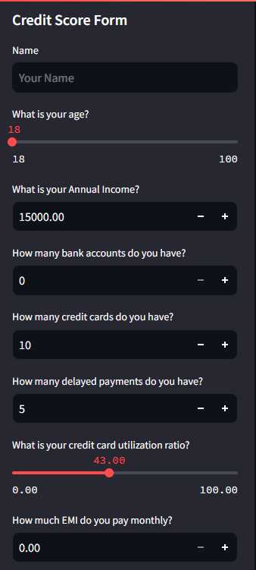
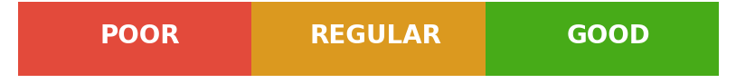
What are we doing?
Machine Learning MODEL
01

Slide 6
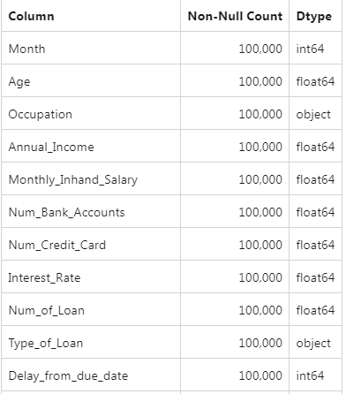
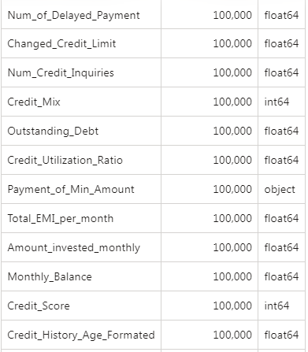
How are we doing it - THE DATASET
01

Slide 7



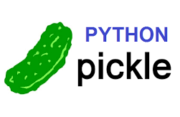




What are we using ?
XGBoost - "eXtreme Gradient Boosting"
Combines the strengths of
Decision trees with
Gradient boosting
Why XGBoost?
Handles Imbalanced Data - Majority come under “Average” category
High Predictive Accuracy - easy identification of defaulters
Feature Importance - Give importances of each parameter
Regularization - Prevent overfitting
Speed and Efficiency
STREAMLIT for a
Simple good looking
User friendly
Interactive
Web frontend
01

Slide 8
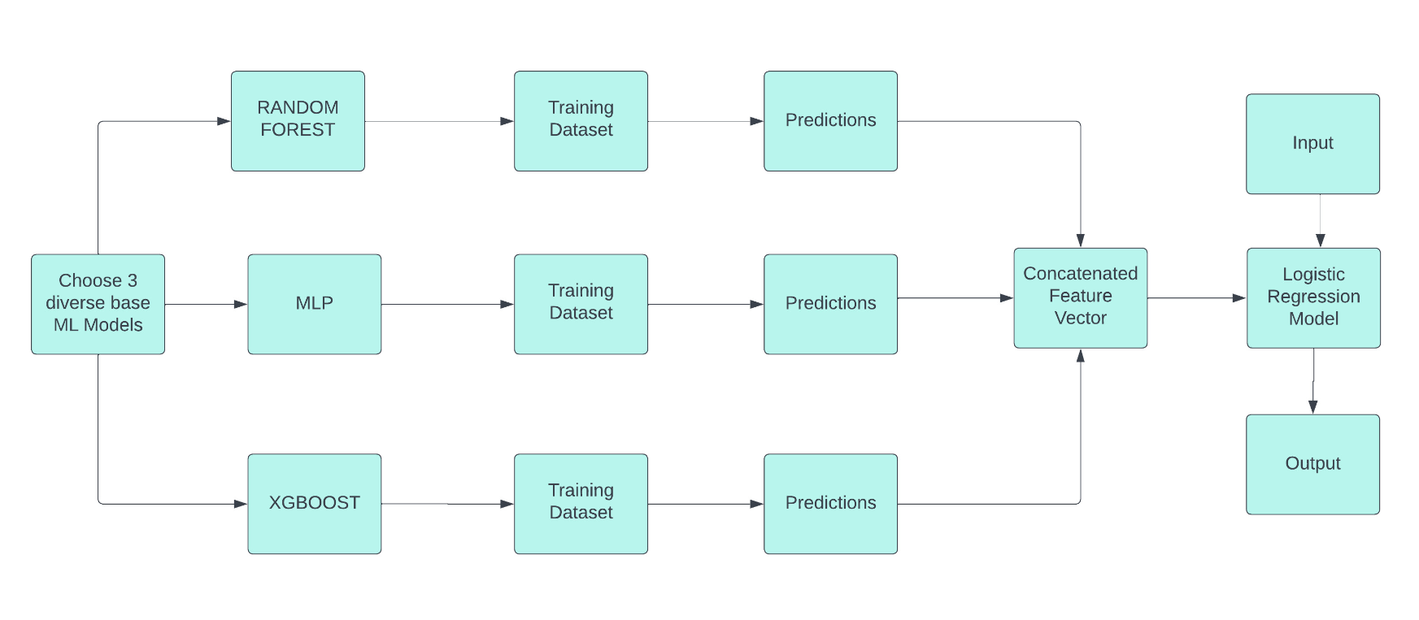
How are we doing it - THE MODEL
01

Slide 9
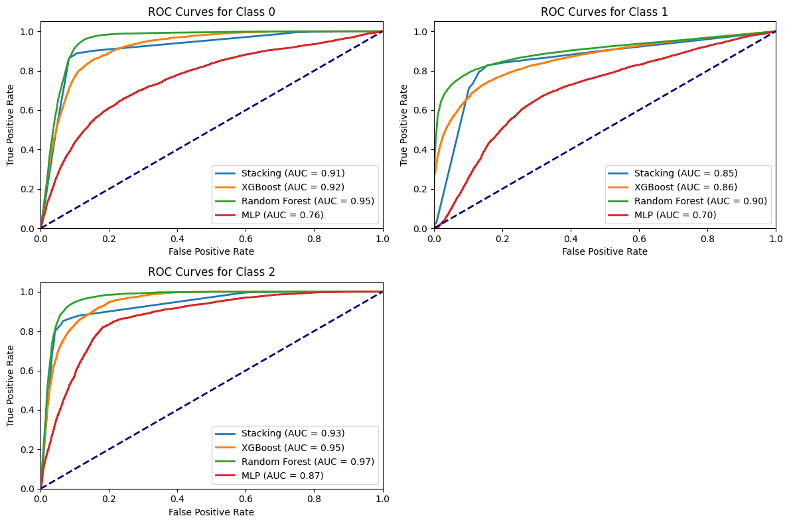
Results
01

Slide 10
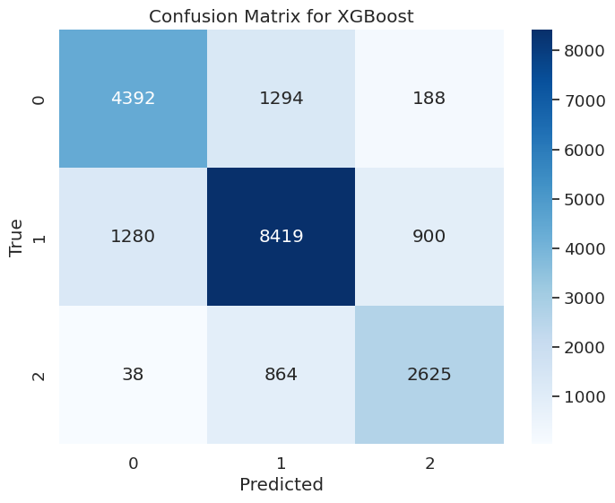
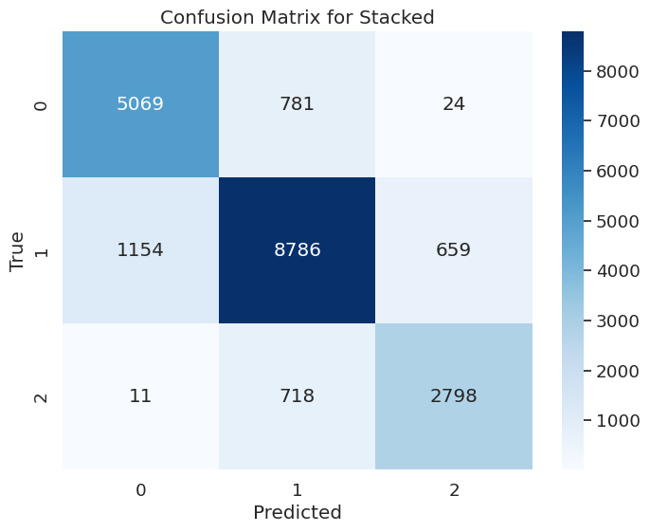
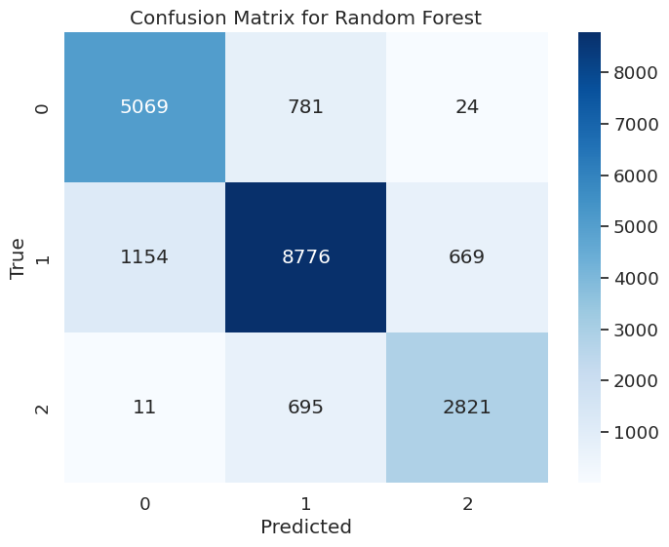
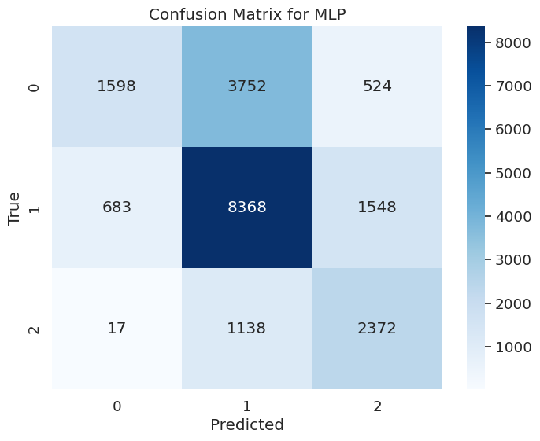
Results
01

Slide 11
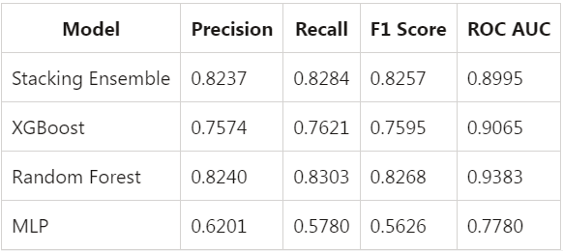
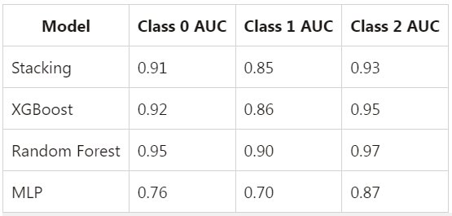
Results
Accuracy metrics for the combination model
Class Wise metrics
01

Slide 12
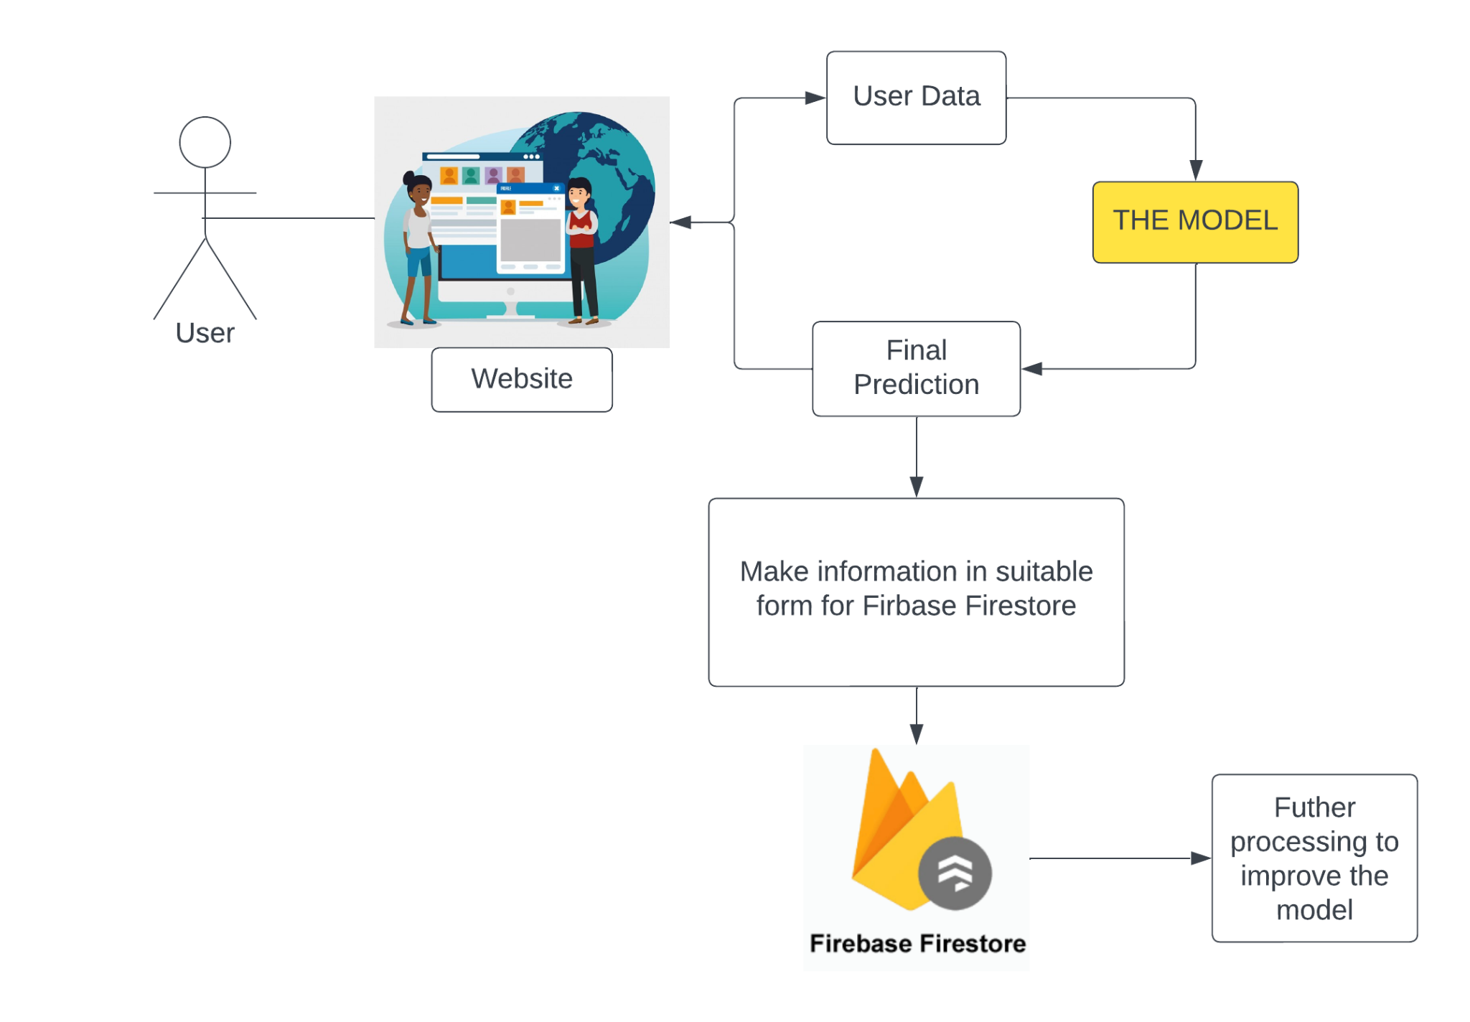
How are we doing it - THE APP WORKFLOW
User Visit: When a user visits our website, they're taking the first step towards finding their category of credit score.
Data Input: The user is prompted to enter their personal details, financial history, and other relevant information. It's like painting a picture of their unique financial journey.
Behind the Scenes: Behind the scenes, our sophisticated system employs cutting-edge machine learning models, as explained in previous slides, to analyze the user's input. It's like a diligent detective, examining every detail.
Credit Score Category: Within moments, the user is presented with their credit score category. This is the compass guiding them towards financial opportunities.
Feature Importances: But we don't stop there. We also provide the user with a breakdown of feature importances. This is like revealing the puzzle pieces that determine their creditworthiness, helping them understand and improve their financial future.
01

Slide 13
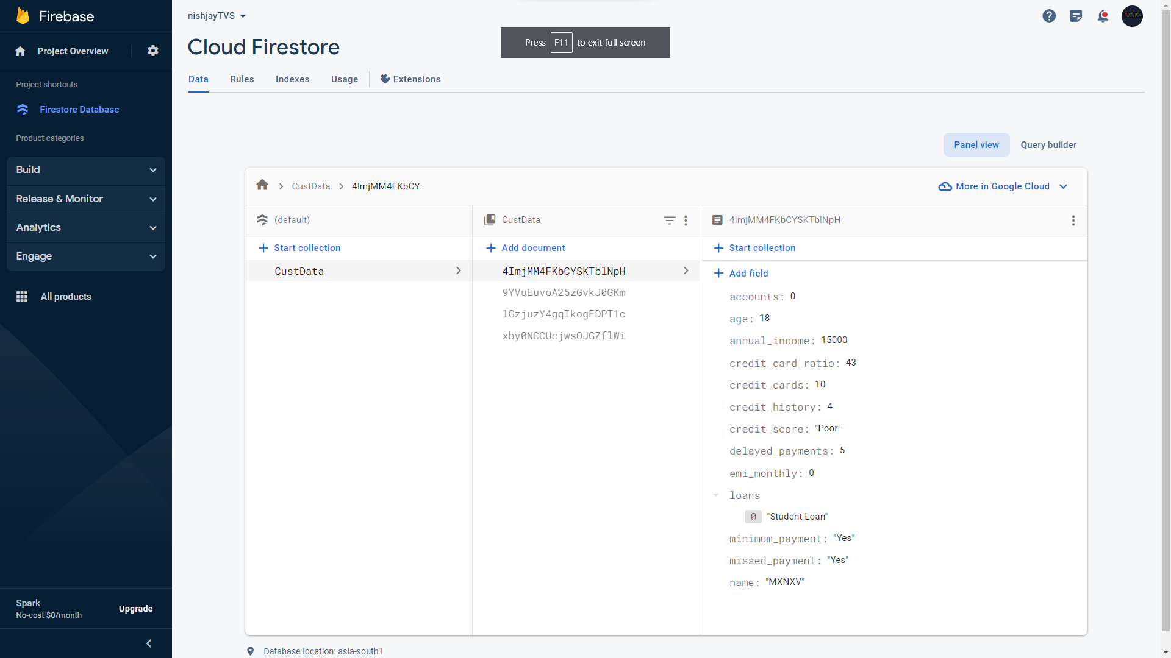
How are we doing it - FIREBASE BACKEND
01

Slide 14
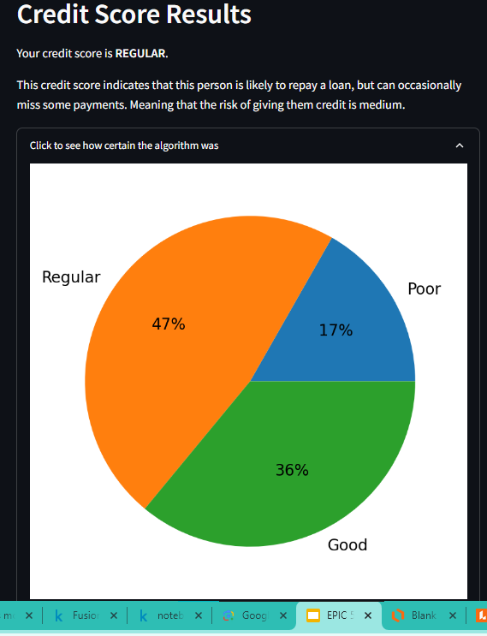
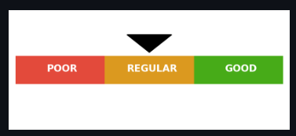
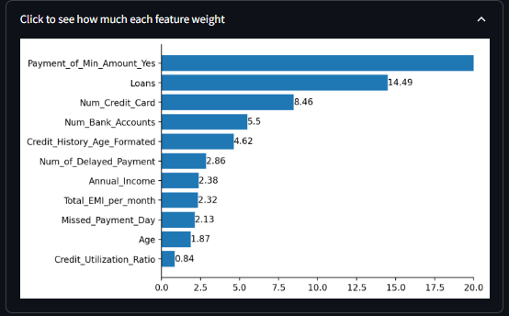
RESULTS - THE APP OUTPUT
01

Slide 15
Thank You
Thank You
01

